Slide 1
Air Quality index by location using mobile sensor cloud
By:
Mohammad Awaise
Aditya B Dhende
Hema Begur
Anuvrat Tiku

Slide 2
Project Introduction
Objective
Air Quality has become a major concern in urban areas.
There is a large impact of air pollution on health, environment and economy.
It is important to have micro-level pollution information.
Our project gives air quality measure at a given location.

Slide 3
Sensors:
1. Sensors will be present at different location .
2. These sensors which are in vehicles, mobile devices, etc. send sensing data.
3. Our project will have virtual sensors which will virtualize these physical sensors.
4. Virtual Sensors will take air composition data from physical sensors and will support start, stop and delete operations.
Functional Services:
1. User and Admin Login
2. User can request and manage sensor.
3. Users can see sensor data.
4. Support for different requirements of user.

Slide 4
Users:
User can be an admin
Normal user will be able to provision sensors and view sensor data
Owners will be able to add and remove sensors from the system.
Users will be able to view sensor status data depending on their user group.

Slide 5
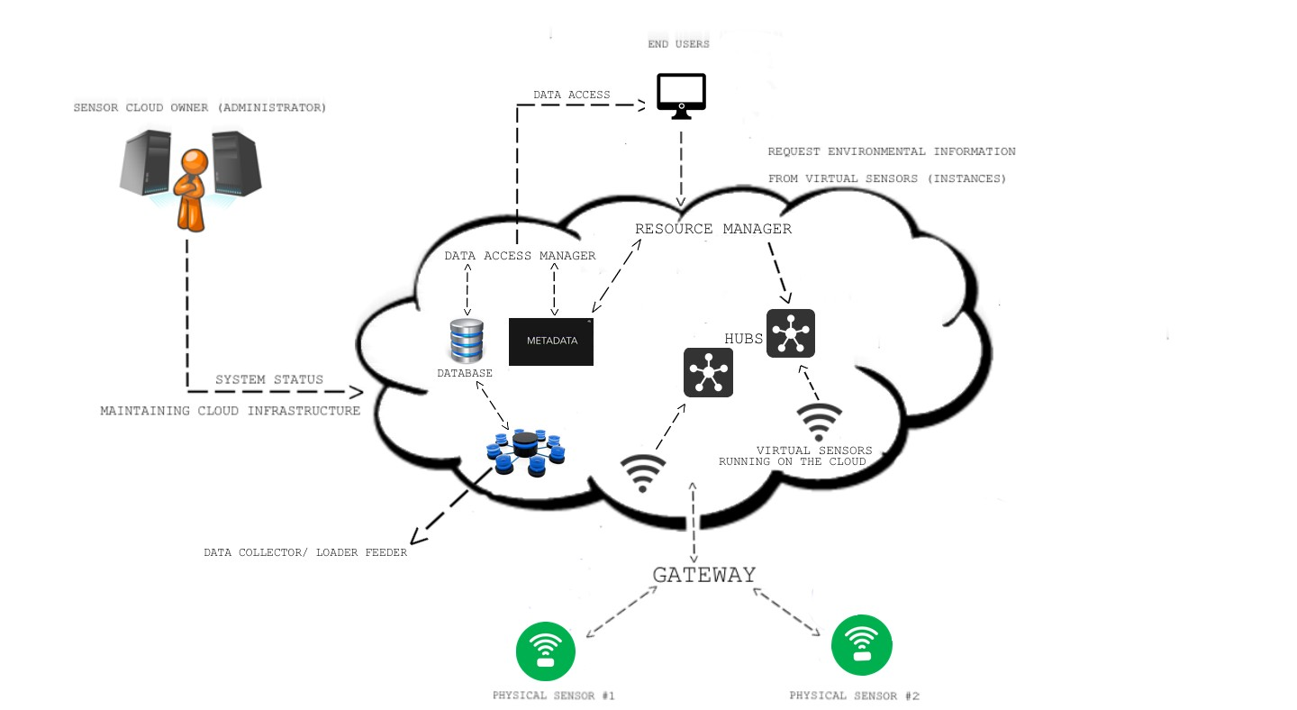
System architecture design
Infrastructure Diagram

Slide 6
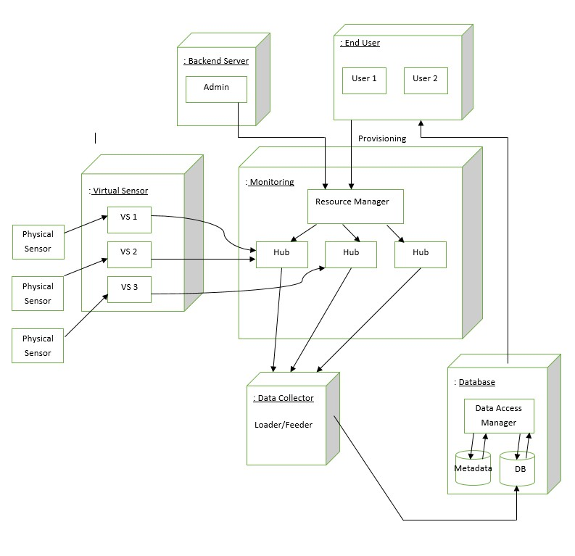
System Design Diagram

Slide 7
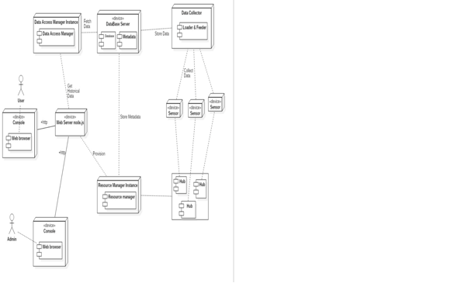
Deployment Diagram

Slide 8
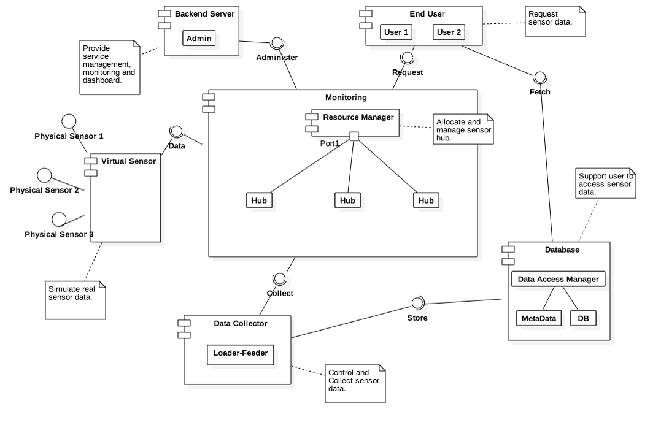
Component Based System Design

Slide 9
ImplementatioN
Implementation
FUNCTIONAL COMPONENTS
Web Server | Node.js
Front End | HTML5, CSS, JavaScript, Bootstrap, AngularJS
Individual Components (Hub, Collector, Data Access Manager, Resource Manager) | Node.js
Databas | Mongo DB, MySQL (Metadata)
Cloud Deployment | Amazon Web Services (AWS) and EC2
Requests and data transfer | RESTful services
Tests & validation environment | Java
TECHNOLOGY/TOOLS

Slide 10
Project summary
1.Our Mobile Sensor Cloud virtualizes physical sensors.
2.Users can provision virtual sensors.
2.Users can utilize these sensors to get air quality details according to location.
4.Users can manage and control sensors through the user dashboard.

